Slide 1
COSC 3337
Dr. Nouhad Rizk
Final Project
May 6, 2023
By: Chase Moreno & Daniel Laz

Slide 2

Introduction: Chosen Dataset
In this project, we chose Auto-MPG dataset from UCI Machine Learning Repository. We chose to work with this dataset because over the years we been talking about cars a lot. Sometimes we just like to joke around about how we are going to buy certain cars when we get older that has more horsepower, types of cylinders, how fast the car’s acceleration can go up to at different speed or miles. Both of us were a fan of watching Fast and Furious Movies and we love different cars that they had like the old model with a lot of horsepower like 1970 Dodge Charger R\T. There are more stuff we can learn about exploring this data, and can’t wait to share it with you to learn more about it.

Slide 3

Introduction: What project type are we going to use?
In this project we will be doing a regression task, which we will predict miles per gallon (mpg) based on the features from the dataset.
The three regression model that we will be using are:
Linear Regression
Ridge Regression
Lasso Regression

Slide 4
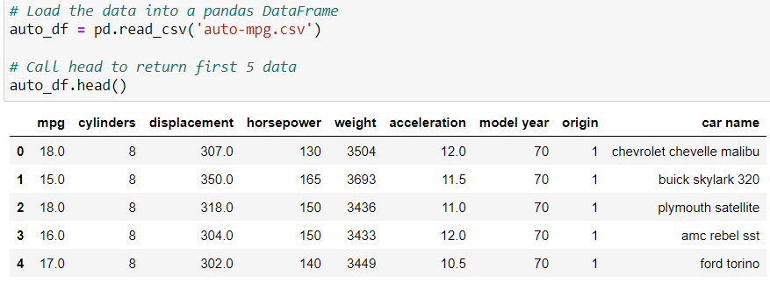
Introduction: Initial Exploratory Analysis
After loading the dataset into a pandas dataFrame. Here is the snapshot of the features from the dataset by calling .head() parameter.

Slide 5
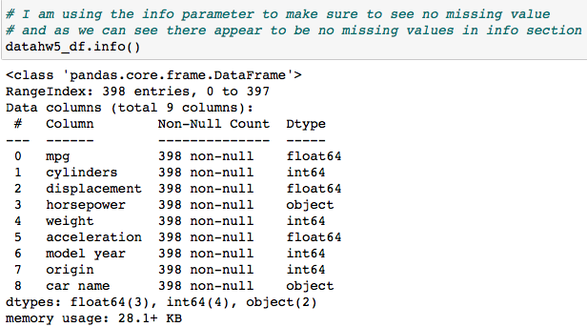
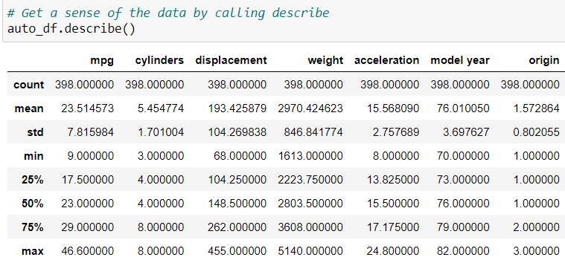
Introduction: Initial Exploratory Analysis
To check the data if there any missing values using info() parameter.
A statistical summary of the data

Slide 6
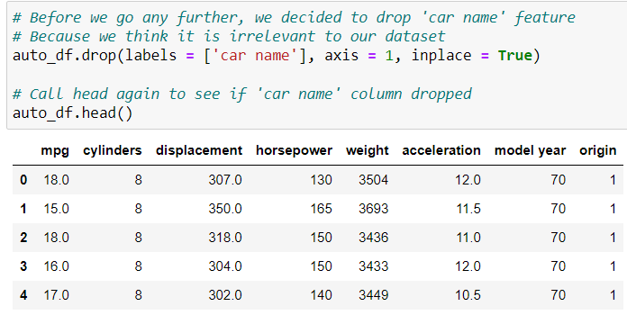
Introduction: Initial Exploratory Analysis
We decided to drop a column called “car name” because it’s irrelevant and it is a categorical variable which we can’t use it.

Slide 7
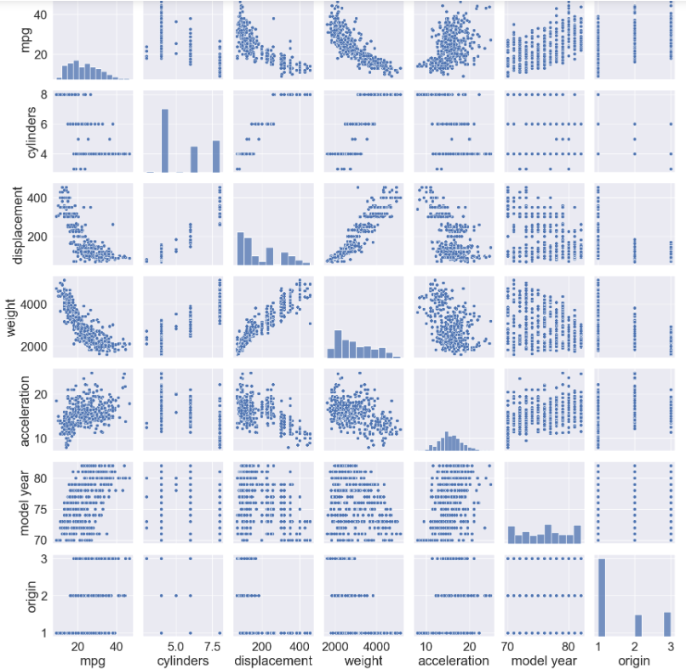
Our pairplot using seaborn

Slide 8

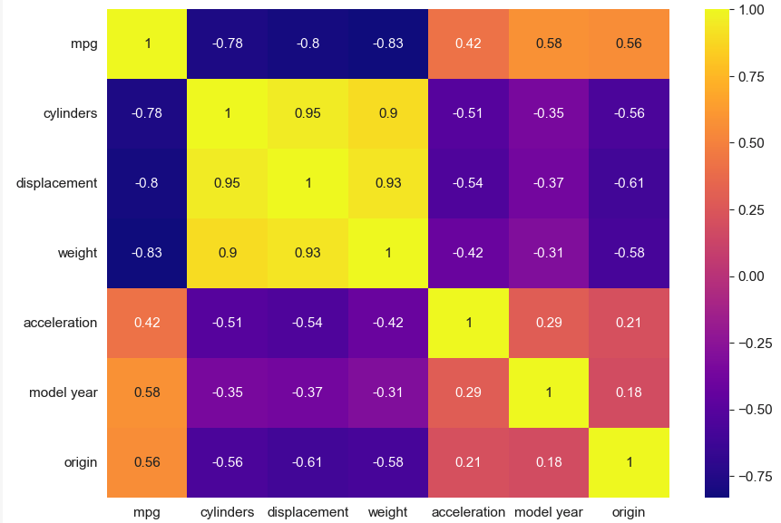
Introduction: Initial Exploratory Analysis
This is the heatmap where we can able to see the correlation relationship between each features of the data.
We have multicollinearity issues that paired relationship with over 0.90 value.
However, we will not remove these feature because we believe that ridge and lasso models should be able to handle them well.

Slide 9
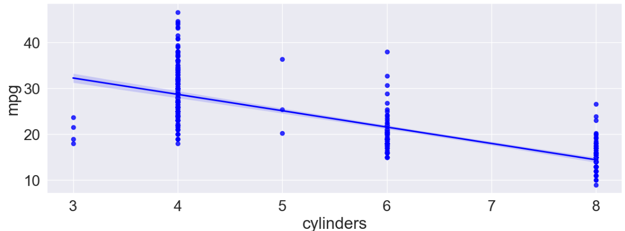
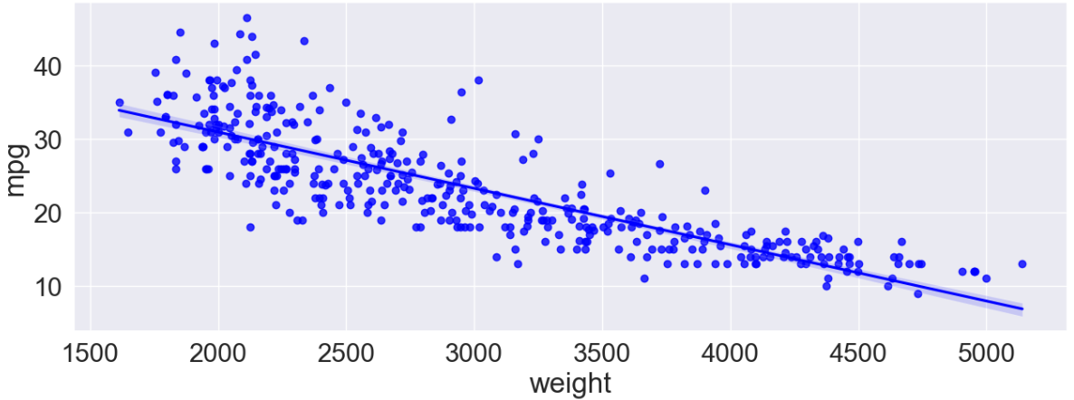
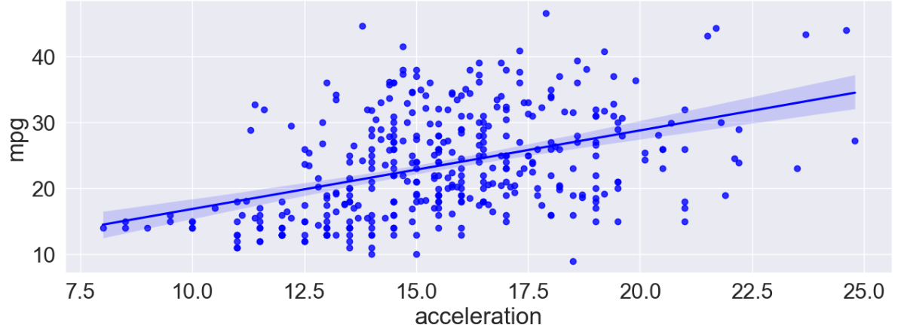
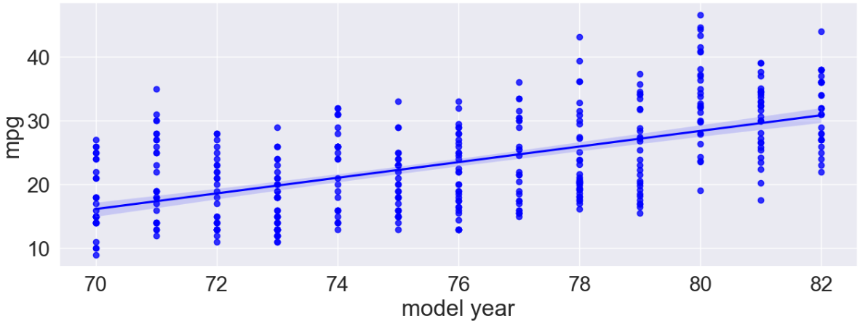
Introduction: Initial Exploratory Analysis
Take a closer look at some of these relationship with mpg

Slide 10
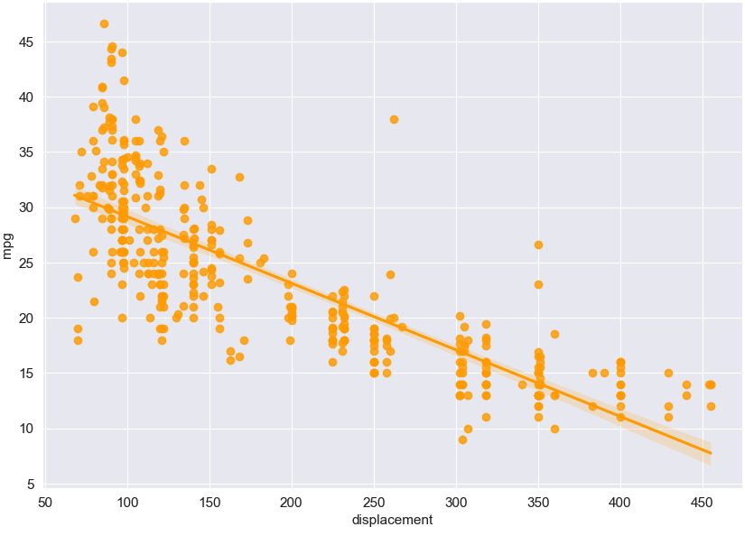
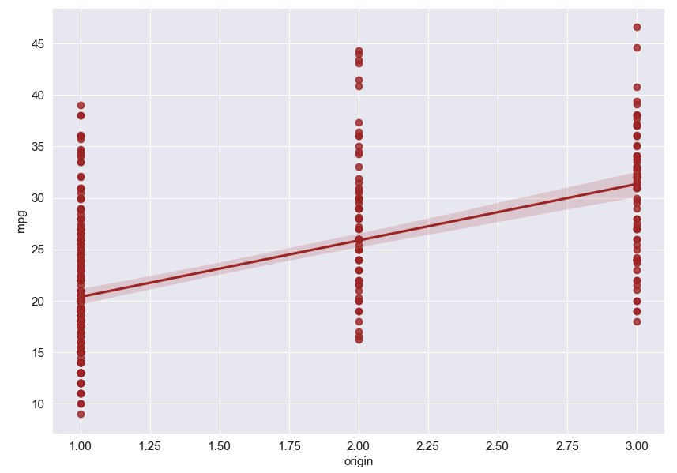
Introduction: Initial Exploratory Analysis

Slide 11
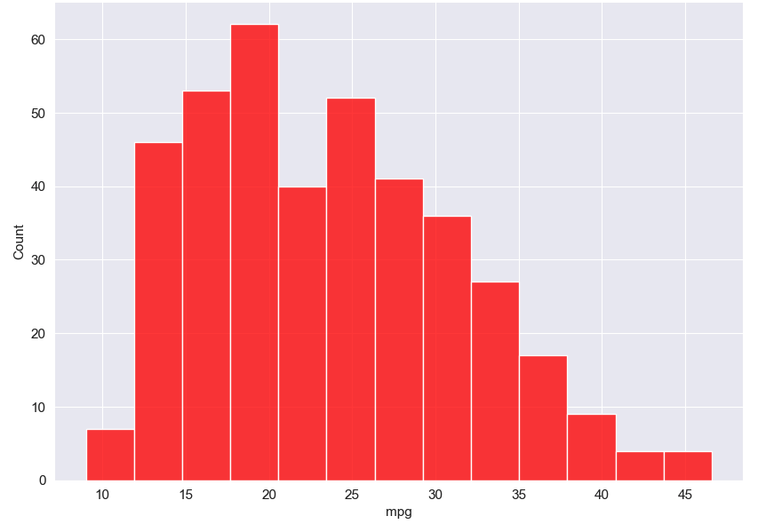
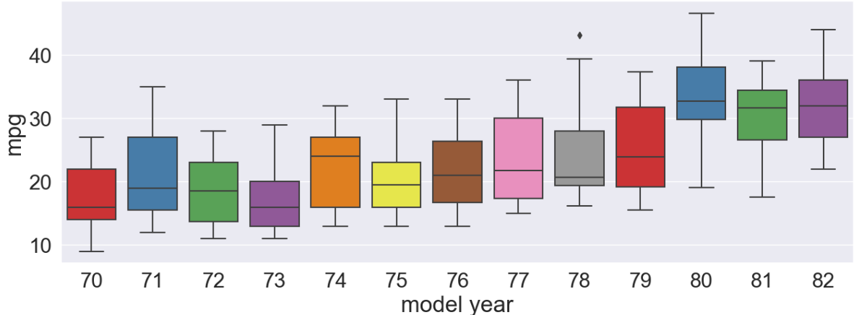
Introduction: Initial Exploratory Analysis
Also here the histplot model of mpg. We can often say that the graph is left skewed that mode is around 18.
Here is a boxplot of model year vs. mpg. We can see an up trend starting from year 73’ to 80’ and then stabilized at mpg value of 30s.

Slide 12
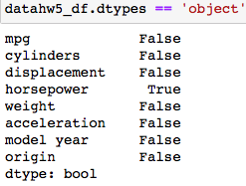
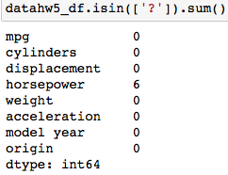
Introduction: Preprocessing
Before we start modeling, we must preprocess our data to make sure if our dataset does not have any missing values. Also, we need to decide if we need to scale our data or not.
We had checked that there are no missing values during in the initial exploratory analysis. However, we decided to check each features using dtypes() parameter to check on the object. Therefore, we actually have missing values which are “?” in ‘horsepower’ feature.

Slide 13
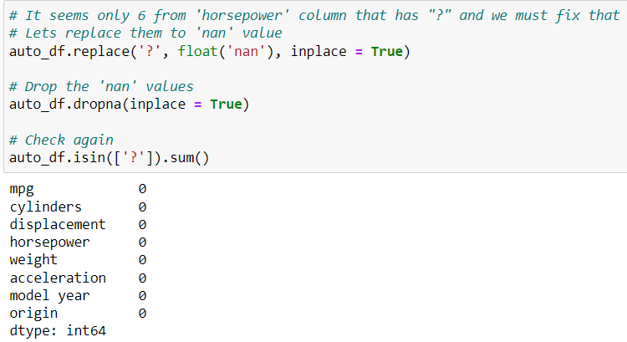
Introduction: Preprocessing
Since we found the missing value are. We replace the “?” to float(‘nan’) where we can able to drop the NaN values by using .dropna(). Then call isin([‘?’]).sum() to check again if the “?” values are removed.

Slide 14

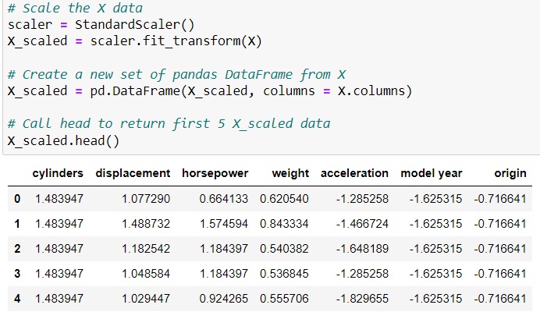
Introduction: Preprocessing
Now the missing values are fixed. We begin to split X and y where we drop the target variable (mpg) from X and assign it to y.
We decided that we will use scaling because we believe that scaling the data is good and keep our data close together. So we will be using Standardscaler which it removes the mean and scales the data to unit variance.

Slide 15
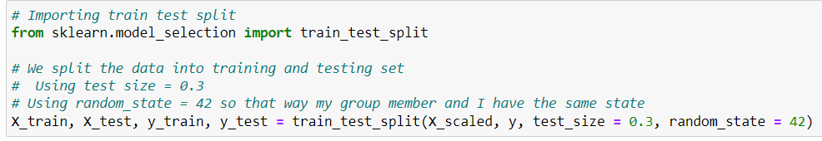
Introduction: Preprocessing
We can start train/test split our data into 70% of training and 30% of testing.

Slide 16
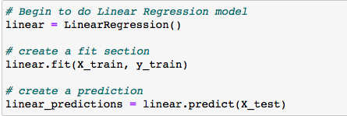
Data Analysis: Linear Regression
Now after we are done scaling our data and train/test split section, we can proceed to move forward by doing the Linear Regression method. First we start by creating the linear regression model then have a fit model with X train and y train and predictions for X test.

Slide 17
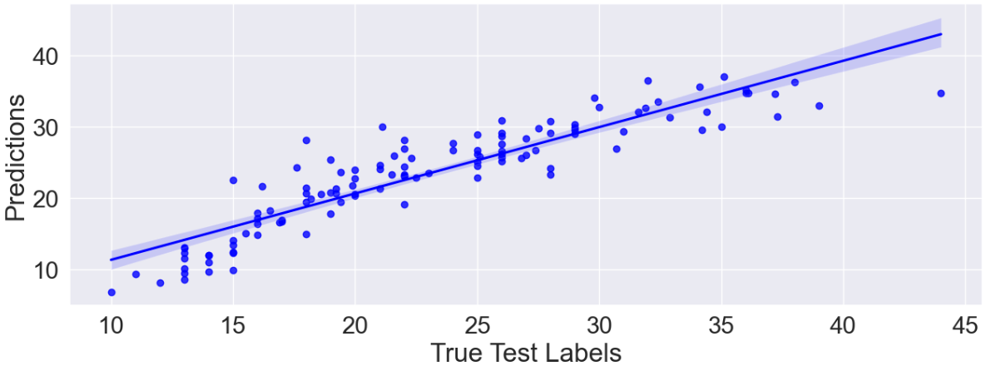
Data Analysis: Linear Regression
A regplot to see how well the linear model is predicting

Slide 18
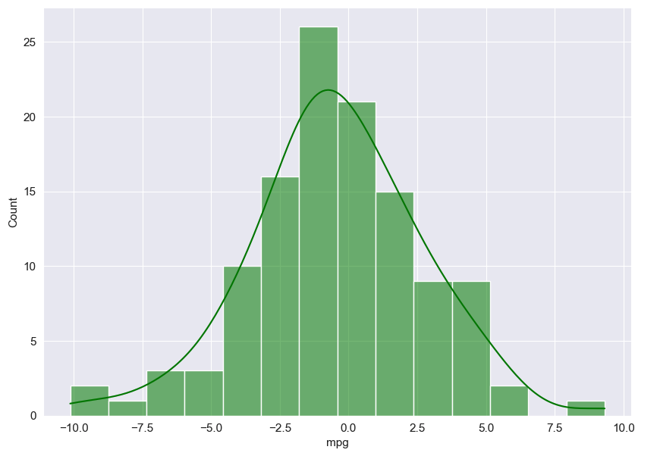
Data Analysis: Linear Regression
Here is the hist plot to see the residuals on test set using Linear model.

Slide 19
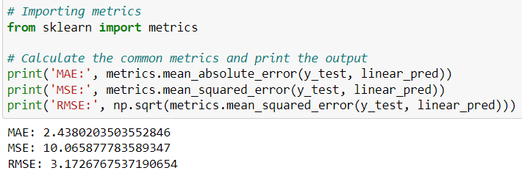
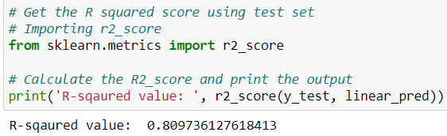
Data Analysis: Linear Regression
We calculated the common metrics errors such as MAE, MSE, and RMSE. The MAE score is 2.438 means that there’s 2.438 values difference between the actual and predicted values on average. The MSE score is 10.066 and its larger because its calculated as average squared. The RMSE score is 3.173 based on the average root squared. They all have a pretty good score because it is close to 0.
We also calculate the R-squared score to see the goodness of fit between the data and the regression model. We have R-squared value of 0.8097 which is a good score. We know that we have multicollinearity in our dataset. We knew it will affect the linear model result in a bad way, but we would like to compare with ridge and lasso model as we go on. However, we are surprised that our model is still great and the score does not go below 0.70s.

Slide 20

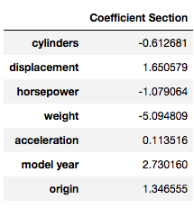
Data Analysis: Linear Regression
Here is the coefficient for each features when predicting the mpg.
As the # of cylinders in a car’s engine increases by 1, the mpg decreased by -0.613. (Larger engines tend to consume more fuel)
Each 1 unit increase in displacement, the mpg increased by 1.651. (Larger engines is likely to be less fuel-efficient)
As the horsepower of a car increases by 1, the mpg decreased by 1.790. (Powerful engines tend to use more fuel)
Each 1 unit increase in weight, the mpg decreased by 5.095. (Heavier cars consume more fuel to be able to move)
As the acceleration of a car increases by 1 second, the mpg increased by 0.114. (Cars with better fuel-efficient tend to have better acceleration)
Each year increase in the model year of a car, the mpg increased by 2.730. (Improvements over the years due to technology)
Each 1 unit increase in origin, the mpg increased by 1.347.

Slide 21
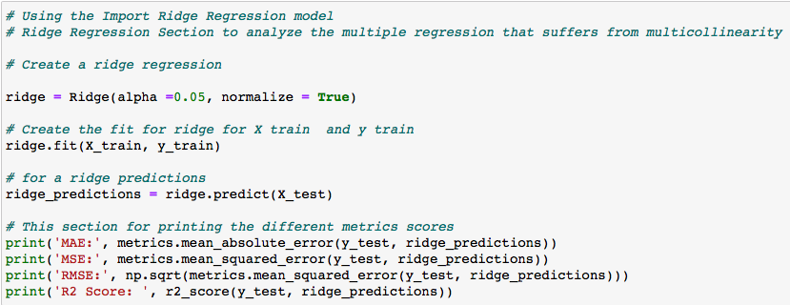

Data Analysis: Ridge Regression
We can proceed to move forward by doing the Ridge Regression method using alpha = 0.05. We have calculated the common metrics errors such as MAE, MSE, RMSE and the R-squared Score. The MAE score is 2.518 while MSE score is 10.647 and RMSE score is 3.263. The MSE score is larger due to squared average being calculated. These metrics score is slightly worse than the linear model because its further away from 0. For the R-squared score, we have 0.799 which is still good, but the R-squared score appear to be lower than the linear model. We thought the results would improve because the ridge model should be able to handle the multicollinearity, so we should not avoid it no matter what.

Slide 22
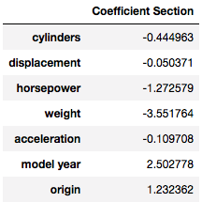
Data Analysis: Ridge Regression
Here the coefficient for the ridge regression by each features.
As the # of cylinders in a car’s engine increases by 1, the mpg decreased by 0.445.
Each 1 unit increase in displacement, the mpg decreased by 0.050.
As the horsepower of a car increases by 1, the mpg decreased by 1.273.
Each 1 unit increase in weight, the mpg decreased by 3.552.
As the acceleration of a car increases by 1 second, the mpg decreased by 0.110.
Each year increase in the model year of a car, the mpg increased by 2.503.
Each 1 unit increase in origin, the mpg increased by 1.232.
Compare to the linear model, we see that the coefficients for ridge model’s cylinders and weight are increased. The rest are decreased.

Slide 23
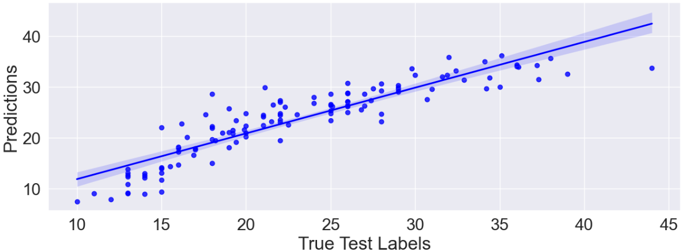
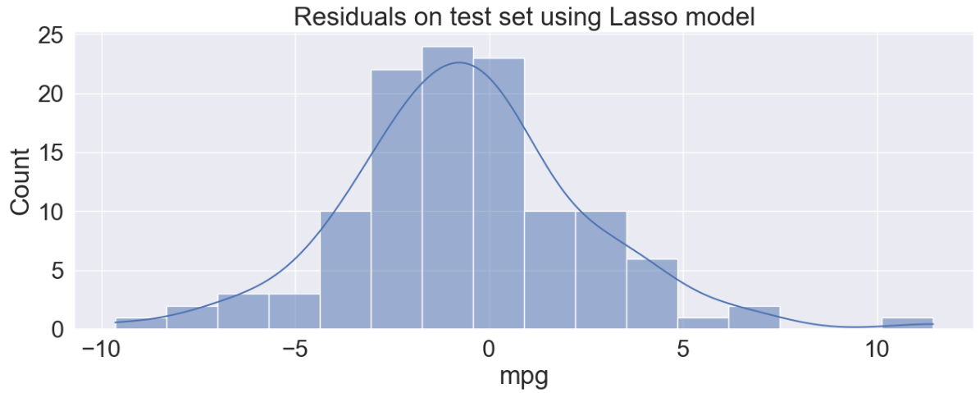
Data Analysis: Ridge Regression
Here is the regplot to see how well the Ridge model is predicting and the residuals on test set using Ridge model. However, these output are very similar to Linear model.

Slide 24
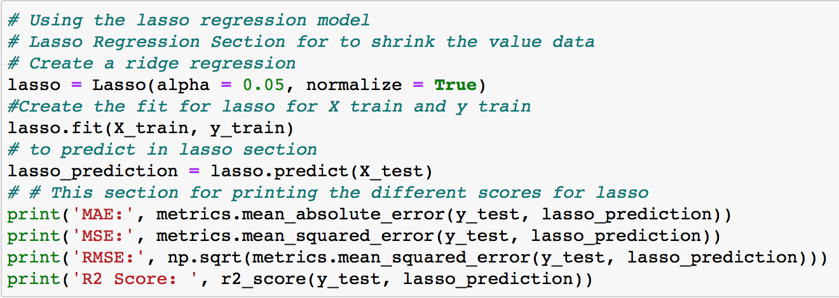

Data Analysis: Lasso Regression
We proceed to do the last method which is the Lasso Regression method. First we start by creating the lasso regression model then have a fit model with X train and y train and predictions for X test. We have calculated the common metrics errors such as MAE, MSE, RMSE and the R-squared Score. The MAE score is 2.354 while MSE score is 9.798 and RMSE score is 3.130. The RMSE score is lower compare to other previous model, which it has the best results and shows a better performance for Lasso model. The R-squared score is 0.81, which appears that it is a good fit for the model and has higher score than any other models.

Slide 25
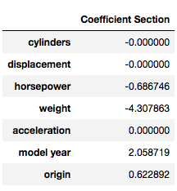
Data Analysis: Lasso Regression
Here is the coefficient for lasso regression by each features.
As the # of cylinders in a car’s engine has no change/effect on the mpg due to coefficient of 0.
Each unit in displacement has no change/effect on the mpg due to coefficient of 0.
As the horsepower of a car increases by 1, the mpg decreased by 0.687.
Each 1 unit increase in weight, the mpg decreased by 4.308.
Acceleration has no change/effect on the mpg due to coefficient of 0.
Each year increase in the model year of a car, the mpg increased by 2.059.
Each 1 unit increase in origin, the mpg increased by 0.623.
Compare to linear and ridge models. We can see that the coefficients for lasso model’s cylinders, displacement, and acceleration increased/decreased to 0. While weight, model year, and origin are decreased. Horsepower is only one increased without becoming 0.

Slide 26


Data Analysis: Lasso Regression
Here is the regplot to see how well the Lasso model is predicting and the residuals on test set using Lasso model. However, these output are very similar to all other models.

Slide 27
Results: Lasso Regression has the best performance than all other models.
After evaluating all three regression model, the lasso regression appear to be the best performance than all other models. The RMSE score is lower compare to other previous model, which it has the best results and shows a better performance. After comparing R-squared score between each model, lasso appear to have higher score than any other models which 0.81 that means it is a good fit for the model. The reason why these scores are better than all other model because lasso model use a technique to shrinks’ the least important features’ coefficient to 0. So, the coefficients of the Lasso model, we can see that it shrunk the features like cylinders, displacement, and acceleration to 0. We assume these features are multicollinearity, which we discovered in our heatmap of the correlation matrix tend to be less important features for our data analysis because it is almost perfectly linear relationship.

Slide 28
Results: What can we improve our analysis for the future?
There many opportunities that we can improve our analysis and the results for this dataset. One of them is to handle the multicollinearity properly will help to improve our results because it does affect the fit of model poorly. We could try to use other scalers such as MinMaxScaler and see if it can do better than using StandardScaler. Also, we could find any outliers and remove them during in the initial exploratory analysis. It is good to do that because it will help to keep the data near by the regression line. We could do more data cleaning and preprocessing the data where we check any more missing values and inconsistent data. For train-test splitting, we might need to use different test size depends on how large/small our dataset are. For ridge and lasso models, we could find the optimal alpha value to get a better performance. So, that way we can avoid having the model underfitting and overfitting which leads the results inaccurate.

Slide 29
THE END
Thank you for joining our presentation.

